Slide 1
1.620821243020 - DANISH RAJA M 2.620821243048 - KALAIYARASAN J 3.620821243023 - DHAKSHINAMOORTHY M 4.620821243053 - KAVIYARASAN K
Sentiment Analysis For Social Media Using BERT Model & XGBoost
Mr A.JEEVA
Assistant Professor / AI&DS
Gnanamani College of Technology,
Namakkal,Tamilnadu,India

Slide 2
Abstract
This project aims to develop a sentiment analysis system for social media platforms using BERT (Bidirectional Encoder Representations from Transformers) and XGBoost (Extreme Gradient Boosting) models. The system will analyze user-generated content, such as tweets and posts, to determine the sentiment expressed (sad, happy, sarcasm, irony). BERT will be used for feature extraction due to its powerful contextual understanding of text, while XGBoost will be employed for classification due to its efficiency and accuracy. The integration of these models will enhance the system's ability to accurately classify sentiments, providing valuable insights for businesses, researchers, and policymakers. This project will leverage state-of-the-art machine learning techniques to create a robust and scalable sentiment analysis solution for social media data.

Slide 3
Objectives
Accurate Sentiment Classification: Develop a system to classify social media posts into various sentiment categories such as sad, irony, sarcasm, and happy.
Enhanced Text Understanding: Utilize BERT's contextual understanding to capture the nuances and context of social media text.
Efficient Classification: Implement XGBoost for efficient and accurate sentiment classification.
Actionable Insights: Provide valuable insights for businesses, researchers, and policymakers to enable data-driven decision-making.

Slide 4
PROBLEM STATEMENT
Social media brims with emotions, from jubilant celebrations to heated debates, but analyzing this vast data to extract meaningful insights is challenging. Informal language, sarcasm, emojis, and multilingual content complicate sentiment analysis.
Real-time processing at scale is essential for businesses, governments, and researchers to understand public opinions, monitor trends, and make data-driven decisions. A robust framework for accurate, scalable sentiment analysis can unlock actionable insights from this digital conversation ecosystem.

Slide 5
Existing system
Traditional Machine Learning Approaches
Sentiment analysis has traditionally been performed using models like Support Vector Machines (SVM) and Naïve Bayes.
These methods rely on feature extraction techniques such as TF-IDF (Term Frequency-Inverse Document Frequency) and word embeddings (FastText, Word2Vec).
Challenges in Existing Systems
Feature Extraction Dependency: Traditional ML models rely on manually designed feature extraction, which may not capture deep semantic meanings.
Limited Context Understanding: Methods like SVM struggle with contextual understanding of words, leading to misclassification.
Performance Bottleneck: Traditional models may achieve high accuracy but are not robust to unseen words or domain-specific slang in social media data.

Slide 6
Proposed system
Deep Learning Integration with BERT & XGBoost
BERT (Bidirectional Encoder Representations from Transformers) will be used for text representation, capturing deeper semantic relationships.
XGBoost (Extreme Gradient Boosting) will be used as the classifier for sentiment prediction, leveraging BERT embeddings as input.
Advantages of the Proposed System
Contextual Understanding: BERT can grasp word meaning in context, reducing misclassification due to polysemy (words with multiple meanings).
Feature Learning: No need for manual feature extraction as BERT automatically generates deep word representations.
Boosted Performance: XGBoost optimizes decision boundaries and enhances classification performance, outperforming traditional ML models.

Slide 7
Role of BERT and XGBoost in Sentiment Analysis
BERT (Bidirectional Encoder Representations from Transformers)
Developed by Google as a state-of-the-art NLP model.
Pre-trained on a large text corpus and fine-tuned for specific tasks like sentiment analysis.
Captures context from both left-to-right and right-to-left in a sentence.
Highly effective for understanding sentiment.
XGBoost (Extreme Gradient Boosting)
A powerful machine learning algorithm known for speed and performance.
Used for classification and regression tasks.
In sentiment analysis, it classifies sentiment based on features extracted by models like BERT.

Slide 8
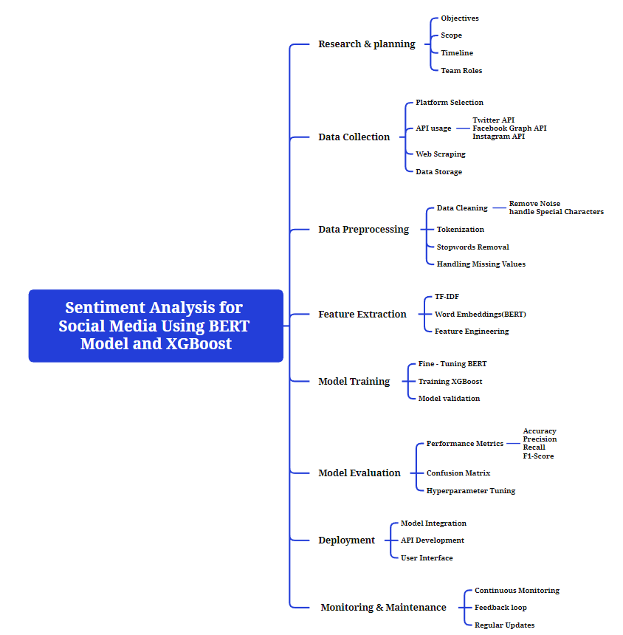
Module Overview

Slide 9
Module 1
Data Collection
The dataset used in this study consists of Twitter-based airline reviews, containing various attributes relevant to sentiment analysis.
tweet_id – Unique identifier for each tweet.
airline_review_sentiment – Sentiment classification of the tweet (positive, negative, or neutral).
airline_ review_ sentiment_confidence – Confidence score associated with the sentiment prediction.
negativereason – Specific reason for negative sentiment (if applicable).
negativereason_confidence – Confidence score for the identified negative reason.
text – Content of the tweet.

Slide 10
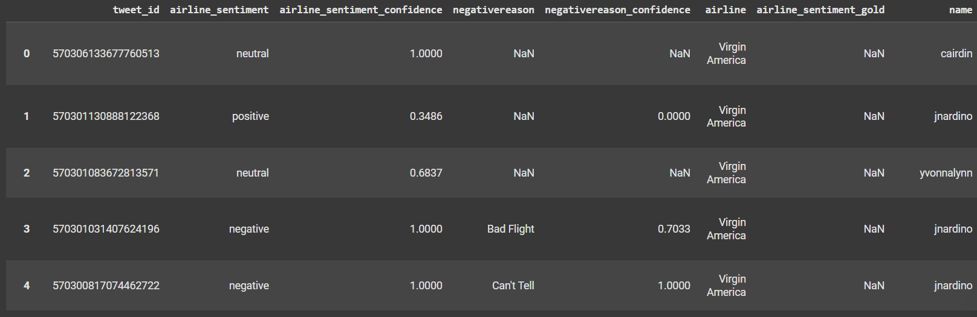
Outcome of Module 1

Slide 11
MODULE 2
Data Preprocessing
Data preprocessing involves cleaning and structuring raw social media data for analysis. Key steps include removing noise (e.g., special characters, URLs, stop words), handling missing data, normalizing text, and detecting languages. Tokenization and lemmatization are applied to convert text into a structured format, enabling effective sentiment classification.
Feature Extraction
Feature extraction identifies crucial elements for sentiment analysis. Techniques include generating word embeddings (e.g., Word2Vec, GloVe) to capture semantic meaning, using N-grams for phrase analysis, and employing sentiment-specific features like emoji and hashtag detection. Advanced methods like TF-IDF or deep learning embeddings enhance the representation of text for model training.

Slide 12
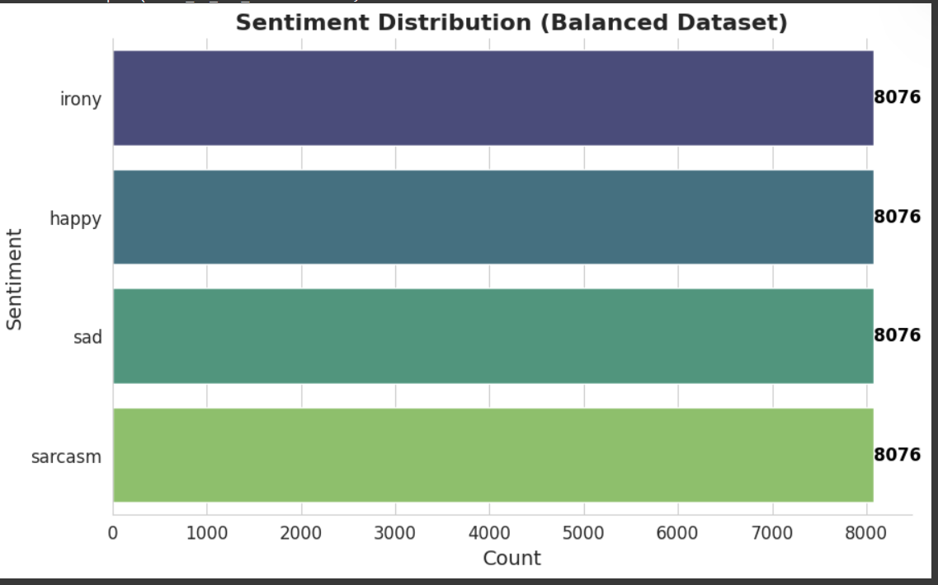
Module 2 Output

Slide 13
Module 3 & 4
Methodology
Feature Extraction:
BERT extracts semantic nuances, ensuring depth in sentiment detection.
Advanced embeddings surpass traditional word representations.
Classification:
XGBoost handles imbalanced datasets efficiently.
Hyperparameter tuning optimizes performance.

Slide 14
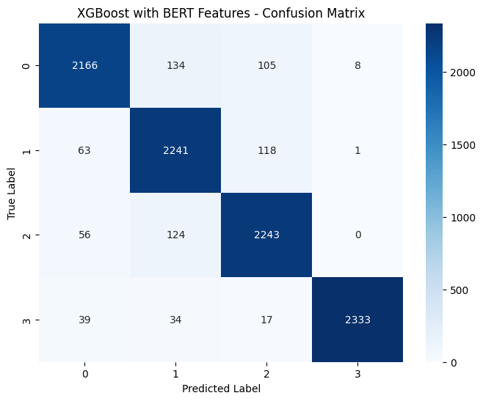
Validation Metrics
Precision, recall, and F1-scores calculated for model evaluation.
Confusion matrix derived to assess misclassification behavior.

Slide 15
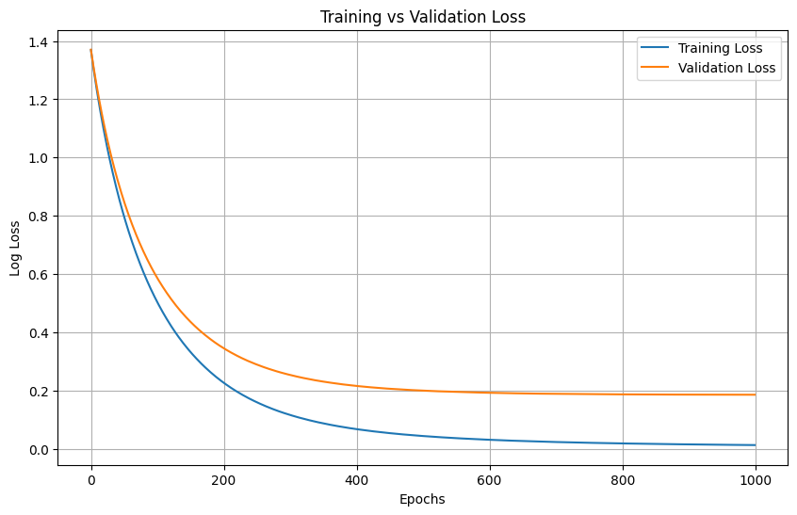
Efficiency Analysis
Time Complexity:
BERT embeddings: High computational cost balanced by batch processing.
XGBoost: Optimal training time with tree-based architecture.
Space Complexity:
Memory-intensive embeddings contrasted with lightweight classification.

Slide 16
Results
Accuracy:
The model achieved an impressive 93% accuracy in sentiment classification.
Insights:
Sarcasm detection validated through confusion matrix analysis.
Balanced distribution across sentiment categories confirmed.
Sentiment | Precision | Recall | F1-Score
Happy | 0.93 | 0.99 | 0.92
Sad | 0.88 | 0.92 | 0.99
Sarcasm | 0.99 | 0.93 | 0.91
Irony | 1.00 | 0.96 | 0.98
Accuracy | 0.93
Macro Avg | 0.93 | 0.93 | 0.93
Weighted Avg | 0.93 | 0.93 | 0.93

Slide 17
MODEL DEPLOYMENT
Component
Frontend | HTML, CSS, JavaScript
Backend | Node.js
Model API | OpenAI API (GPT-3.5/GPT-4)
Visualization | Chart.js
Hosting | AWS
Database (optional) | MongoDB

Slide 18
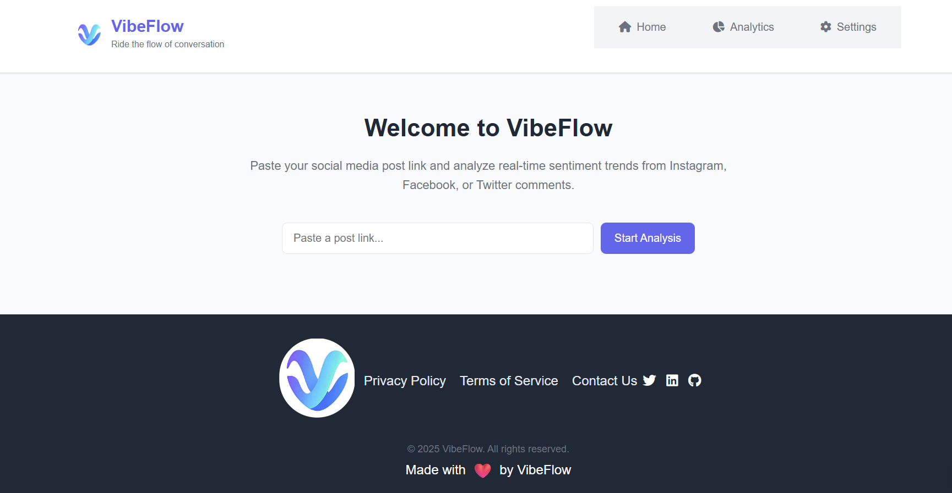
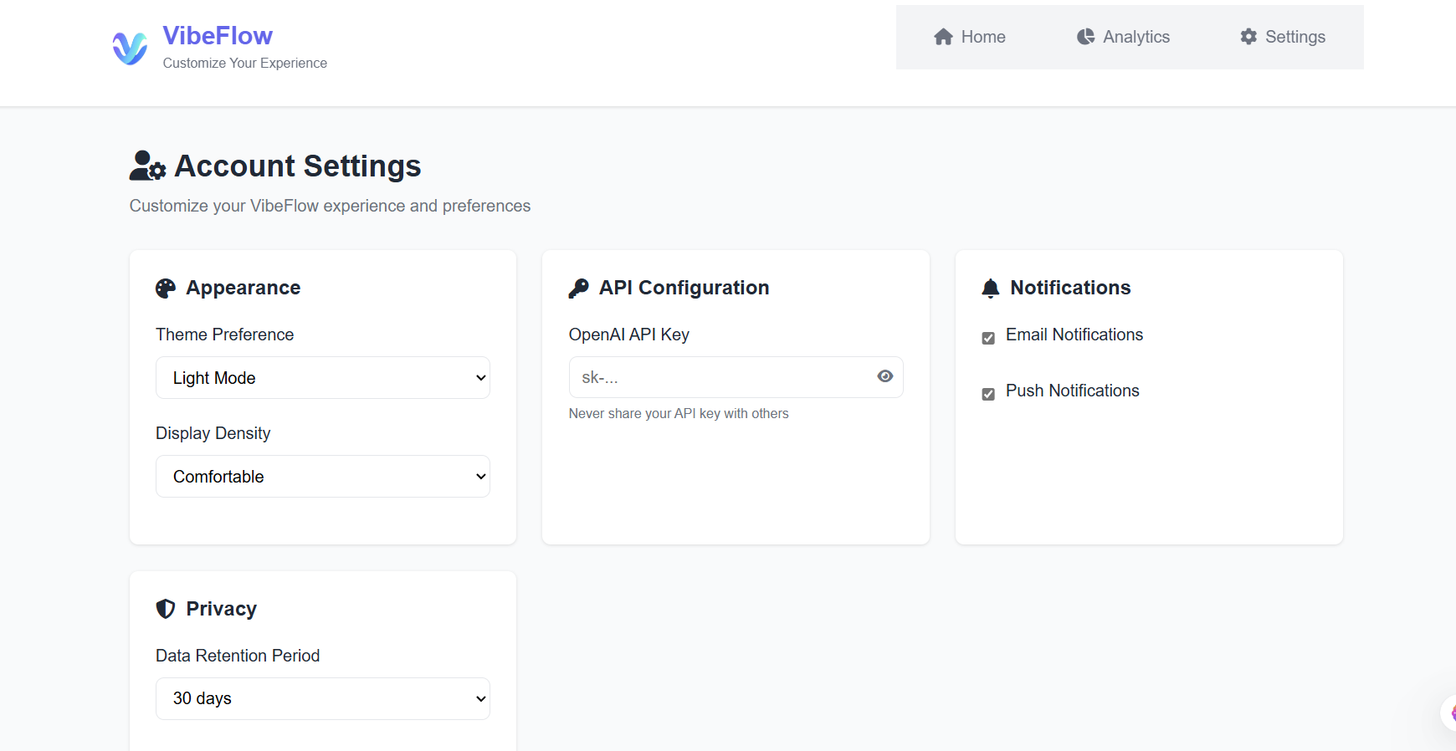
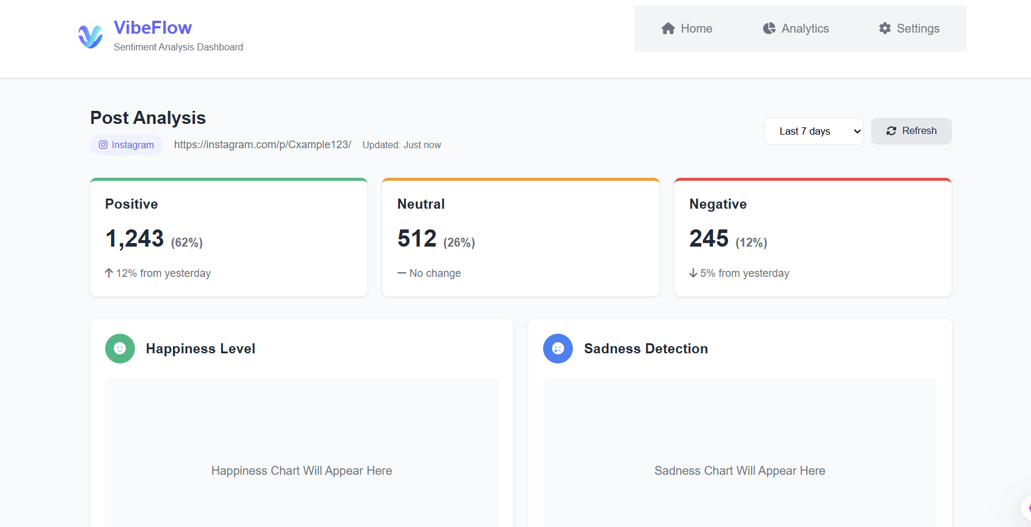

Slide 19
Reference
I. Kurniawan and A. Susanto, “Implementasi Metode K-Means dan Naïve Bayes Classifier untuk Analisis Sentimen Pemilihan Presiden (Pilpres) 2019,” Eksplora Informatika, vol. 9, no. 1, pp. 1–10, Sep. 2019, doi: 10.30864/eksplora.v9i1.237.
A. F. Sabily, P. P. Adikara, and M. A. Fauzi, “Analisis Sentimen Pemilihan Presiden 2019 pada Twitter menggunakan Metode Maximum Entropy,” Jurnal Pengembangan Teknologi Informasi dan Ilmu Komputer , vol. 3, pp. 4204–4209, May 2019.
M. M. Ismail and K. M. Lhaksamana, “Sentimen Analisis Pada Media Online Mengenai Pemilihan Presiden 2019 Dengan Menggunakan Metode Naive Bayes,” e-Proceeding of Engineering, vol. 6, pp. 9997–10004, Aug. 2019.
Hoang M, Bihorac O A, Rouces J. Aspect-based sentiment analysis using bert[C]//Proceedings of the 22nd nordic conference on computational linguistics. 2019: 187-196.
Xu H, Liu B, Shu L, et al. BERT post-training for review reading comprehension and aspect-based sentiment analysis[J]. arXiv preprint arXiv:1904.02232, 2019.
Li X, Bing L, Zhang W, et al. Exploiting BERT for end-to-end aspect-based sentiment analysis[J]. arXiv preprint arXiv:1910.00883, 2019.
Singh M, Jakhar A K, Pandey S. Sentiment analysis on the impact of coronavirus in social life using the BERT model[J]. Social Network Analysis and Mining, 2021, 11(1): 33.
Samih A, Ghadi A, Fennan A. Enhanced sentiment analysis based on improved word embeddings and XGboost[J]. International Journal of Electrical & Computer Engineering (2088-8708), 2023, 13(2).

